Slide 1
7-1 Final Project Presentation
Student: Cory Remick
CS-250
Professor: Cindrell Harry
2/19/2022

Slide 2

Agile Roles
Product Owner
Scrum Master
Developers/Testers
Notes:
Schwaber, The Scrum Guide pg. 5-6
Product Owner
The Product Owner is responsible for:
Developing and Communicating the Product Goal
Creating and communicating the Backlog items (User Stories)
Ensuring that the Backlog is visible and understood by all interested parties above, at level, and below.
Those wanting the Backlog to change must convince the Product Owner.
Scrum Master
The Scrum Master is responsible for helping everyone understand Scrum theory and practice.
The Scrum Master facilitates the team in improving its practices within the Scrum phases.
The Scrum Master practices servant leadership through the following:
Coaching team members in self-management and cross-functionality
Helping the Scrum team create quality Increments that meet the “Definition of Done”.
Removes stumbling blocks impeding the team’s progress.
Ensures that Scrum Events take place and are productive, positive, and timely.
The Scrum Master assists the Product Owner by:
Defining effective Product Goals
Assist in creating clear and well-defined User Stories
Establishing empirical project planning through project velocity measurement
Facilitating stakeholder collaboration
The Scrum Master assists the Organization by:
Leading, training, and coaching the organization in Scrum adoption
Planning and advising Scrum implementations within the organization
Help enact empirical measurements for employees and stakeholders
Remove barriers between stakeholders and Scrum teams.
Developers/Testers
Skills can vary based on the scope of work creating an interdisciplinary team.
All are responsible for:
Creating a plan for the Sprint from the Backlog which becomes the Sprint Backlog
Upholding quality by meeting the “Definition of Done”.
Adapting their plan to meet the Sprint Goal
Holding each other accountable as team members

Slide 3
Agile Phases
Planning
Sprint
Planning
Daily Scrum
Review
Retrospective
Notes:
Schwaber, The Scrum Guide pg. 7-10
As with any development method, a Product Goal is defined. The development method is defined to achieve that goal.
The product goal defines the value to the organization that needs to be met, defines who is responsible for it, and can include how they are to conduct themselves.
For Agile development, the Product Goal begins with high level planning.
Planning is articulated through stories that capture the essence of what a feature does, who does it, and what value they get from it. These stories form a product backlog. These backlog stories can be prioritized to determine what should be acted on next and can provide the start to further discussions on how to do it.
A sprint is a period defined up front, in which the team believes is enough time to deliver on the objectives of the project. A sprint is typically between a week and a month.
Sprint planning is taking enough Product Backlog items that can be completed in the period given and defining what needs to happen to fulfill the backlog item. Questions are asked that further define the story. Tasks are defined and assigned. Goals are defined that form the definition of done. Test plans are defined that help enforce the definition of done.
Execution begins and a daily meeting is held called the Daily Scrum. In the Scrum each developer and tester states what they did, what they are going to do next, and bring up any impediments that happened or are happening. These daily meetings are limited to 15 minutes in order to keep things concise and not waste time. During the sprint, goals or requirements cannot be changed. If changes to the Product Backlog are needed the stories can be updated and reprioritized for the next sprint planning cycle.
At the end of the Sprint, the developers present their work to stakeholders for review. This gives the stakeholders input, and if warranted, changes are incorporated into the next Sprint plan. The review should be no longer than four hours for a one-month sprint and less for shorter sprints.
Finally, the Scrum team holds a Sprint Retrospective. The purpose of the retrospective is to review how the process worked and what can be done to improve before another sprint is started. The meeting should be limited to three hours for a one-month sprint or less for shorter sprints. The review should look at team members, interactions, processes, tools, and quality. Improvements should be incorporated into the next sprint cycle.
Until the Product Backlog is empty the Sprint returns to planning for another cycle. If executives believe that the current value is enough, they can suspend the backlog and declare the project done. Or they can determine if more value is warranted and then let the backlog grow and the project will continue.

Slide 4
Waterfall Phases
System Requirements
Software Requirements
Analysis
Program Design
Coding
Testing
Operations
Notes:
Cobb, Chapter 2, Agile Early History
Cobb, Chapter 1, The Evolution of Agile and Waterfall
Waterfall is plan driven
Execution moves through phases sequentially
Suitable for projects that are small and/or well-defined
Suitable for projects in which rapid changes in iterations are costly (time, resources, money), for example, hardware development or construction
Drawback when Testing reveals design flaws too late to be fixed without significant rework

Slide 5
When to use Agile versus Waterfall
Agile
Waterfall
Project requirements are vague
Stakeholders need to provide regular feedback
Work can be executed in parallel
More suited for software development
Project requirements are well-defined
Stakeholders can wait till done
Work must execute sequentially
More suited for manufacturing and construction
Notes:
Cobb, Chapter 2, Agile Early History
Cobb, Chapter 1, The Evolution of Agile and Waterfall
If the project requirements aren’t well-defined then an Agile approach will allow the team to pivot between sprints. When the project is well-defined then it can be more efficient for cost estimation and task planning to use the Waterfall method.
If stakeholders need to view and make changes frequently, then an Agile approach may be warranted. If stakeholders can define their needs upfront, then it may also be true that they can wait to see the result when the project is done.
If the project can be executed in parallel, then an Agile approach may be more appropriate. However, if the work must go sequentially through the development phases, then the waterfall warranted.
For organizations that do hardware development, and their supplier is oversees and it takes months to get the prototypes back for testing a well-defined requirement a Waterfall method would be more appropriate. But when changes can be quickly and cheaply made such as in software development, then an Agile approach is a better choice.

Slide 6
When to use Agile versus Waterfall
Agile
Waterfall
Project requirements are vague
Stakeholders need to provide regular feedback
Work can be executed in parallel
More suited for software development
Project requirements are well-defined
Stakeholders can wait till done
Work must execute sequentially
More suited for manufacturing and construction
Notes:
Cobb, Chapter 2, Agile Early History
Cobb, Chapter 1, The Evolution of Agile and Waterfall
If the project requirements aren’t well-defined then an Agile approach will allow the team to pivot between sprints. When the project is well-defined then it can be more efficient for cost estimation and task planning to use the Waterfall method.
If stakeholders need to view and make changes frequently, then an Agile approach may be warranted. If stakeholders can define their needs upfront, then it may also be true that they can wait to see the result when the project is done.
If the project can be executed in parallel, then an Agile approach may be more appropriate. However, if the work must go sequentially through the development phases, then the waterfall warranted.
For organizations that do hardware development, and their supplier is oversees and it takes months to get the prototypes back for testing a well-defined requirement a Waterfall method would be more appropriate. But when changes can be quickly and cheaply made such as in software development, then an Agile approach is a better choice.

Slide 7
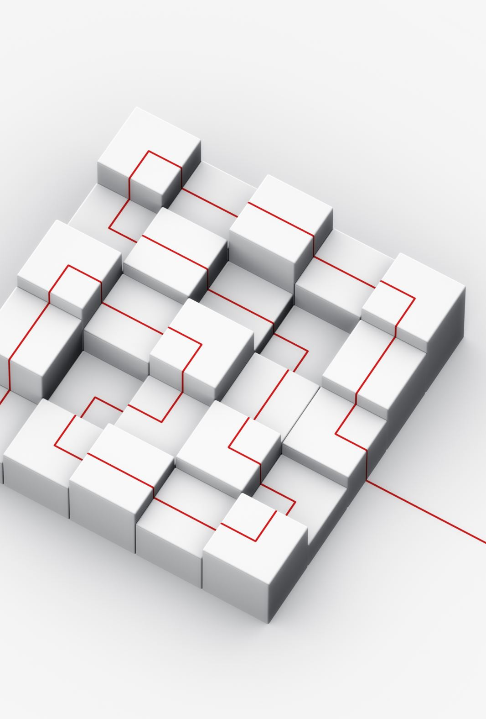
References
Cobb, C. G. (2015). The Project Manager’s Guide to Mastering Agile : Principles and Practices for an Adaptive Approach. Wiley.
Schwaber, K., & Sutherland, J. (2022, 1 15). The Scrum Guide. Retrieved from Scrum Guides: https://scrumguides.org/docs/scrumguide/v2020/2020-Scrum-Guide-US.pdf#zoom=100

